Slide 1
Python Package Pandas - Data Manipulation
Programming for Data Science (11521)
Week 10

Slide 2
Pandas
Source: Kevin Markham - https://github.com/justmarkham
Pandas doc: http://pandas.pydata.org/pandas-docs/stable/index.html
Series: a one-dimensional labeled array capable of holding any data type (integers, strings, floating point numbers, Python objects, etc.). The axis labels are collectively referred to as the index. The basic method to create a Series is to call pd.Series([1,3,5,np.nan,6,8])
DataFrame: a 2-dimensional labeled data structure with columns of potentially different types. You can think of it like a spreadsheet or SQL table, or a dictionary of Series objects. It stems from the R data.frame() object.

Slide 3
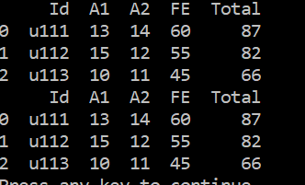
Create DataFrame
import pandas as pd
cols = ['Id', 'A1', 'A2', 'FE', 'Total’]
df1 = pd.DataFrame(
[['u111', 13, 14, 60, 87],
['u112', 15, 12, 55, 82],
['u113', 10, 11, 45, 66]],
columns=cols)
print(df1)
df2 = pd.DataFrame(
dict(Id=['u111', 'u112', 'u113'],
A1=[13, 15, 10],
A2=[14, 12, 11],
FE=[60, 55, 45],
Total=[87, 82, 66]))
print(df2)

Slide 4
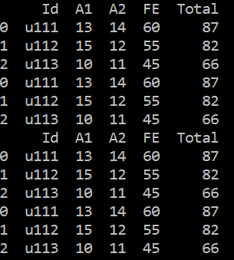
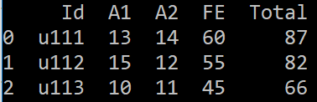
Concatenate DataFrames
df3 = df1.append(df2)
print(df3)
df4 = pd.concat([df1, df2])
print(df4)
df4 = df4.drop_duplicates()
print(df4)

Slide 5


Join DataFrames using Inner and Outer
import pandas as pd
df2 = pd.DataFrame(
dict(Id=['u111', 'u112', 'u113'],
A1=[13, 15, 10],
A2=[14, 12, 11],
FE=[60, 55, 45],
Total=[87, 82, 66]))
#print(df2)
df5 = pd.DataFrame(
dict(Id=['u111', 'u112'],
Grade=['HD', 'DI']))
df6 = pd.merge(df2, df5, on='Id')
print(df6)
df7 = pd.merge(df2, df5, on='Id', how='outer')
print(df7)

Slide 6
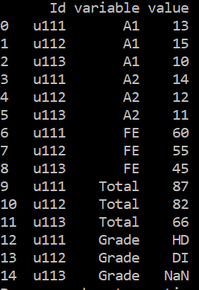
Unpivot a DataFrame from wide format to long (stacked) format
stacked = pd.melt(df7, id_vars='Id', var_name='variable', value_name='value')
print(stacked)

Slide 7
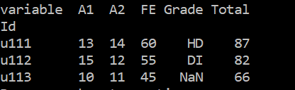
Pivot a DataFrame from long (stacked) format to wide format
df8 = stacked.pivot(index='Id', columns='variable', values='value')
print(df8)

Slide 8
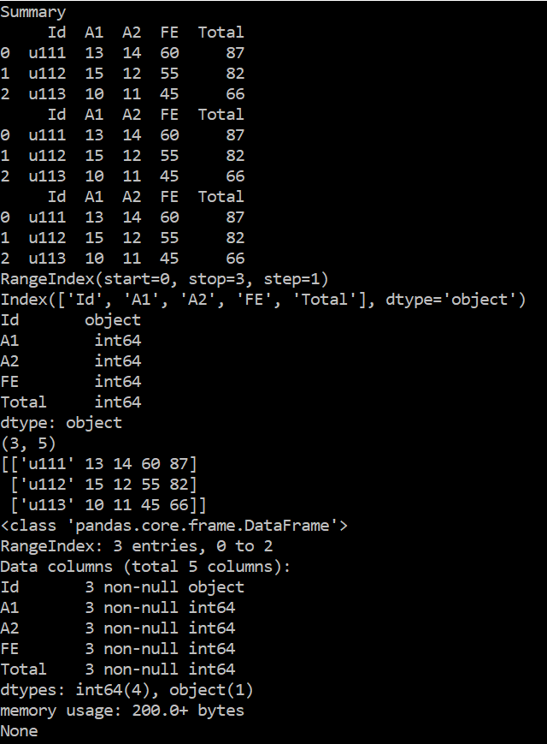
Summary
print('Summary')
print(df1)
print(df1.head())
print(df1.tail())
print(df1.index)
print(df1.columns)
print(df1.dtypes)
print(df1.shape)
print(df1.values)
print(df1.info())

Slide 9
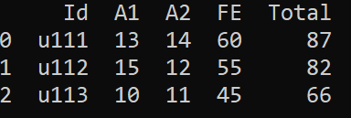
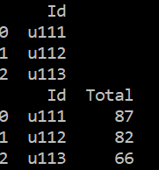
Select columns
col0 = ['Id']
print(df1[col0])
print(df1)
col04 = ['Id', 'Total']
print(df1[col04])

Slide 10

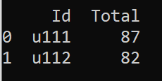
Select columns and rows
col0 = ['Id']
print(df1[col0][0:1])
print(df1)
col04 = ['Id', 'Total']
print(df1[col04][:-1])
col0 = ['Id']
print(df1[col0][0])
col04 = ['Id', 'Total']
print(df1[col04][-1])

Slide 11



Select columns and rows
print(df1[df1.Total > 80])
print(df1[(df1.Total > 80) & (class1.A1 == 15)])
print(df1[(df1.Total > 80)].A1)

Slide 12
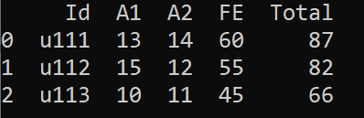

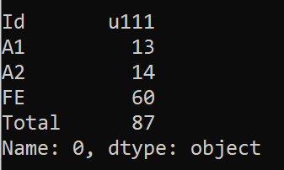
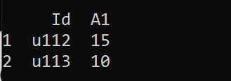
Select columns and rows using iloc or loc function
print(df1)
print(df1.iloc[0, 2])
print(df1.loc[0, 'A2'])
or
print(df1.iloc[0])
print(df1.loc[0])
print(df1.iloc[1:3, 0:2])
print(df1.loc[1:3, 'Id':'A2'])
or
or

Slide 13
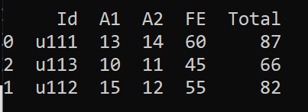
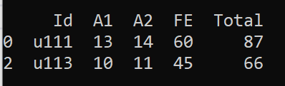
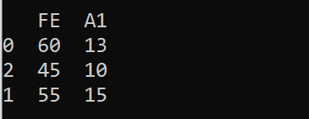
Select columns and rows using iloc or loc function
print(df1.iloc[[0,2,1]])
print(df1.loc[[0,2,1]])
print(df1)
or
print(df1.iloc[[0,2]])
print(df1.loc[[0,2]])
print(df1.iloc[[0,2,1], [3,1]])
print(df1.loc[[0, 2, 1], ['FE','A1']])
or
or

Slide 14


Select columns and rows using iloc or loc function
print(df1)
print(df1.iloc[2, 4])
print(df1.loc[2, 'Total'])
or
print(df1.iloc[[2], [4]])
print(df1.loc[[2], ['Total']])
or

Slide 15
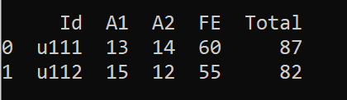
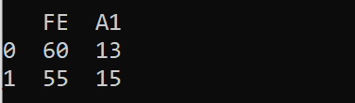

Select columns and rows using iloc or loc function
print(df1)
print(df1.loc[df1.Total > 80])
print(df1.loc[df1.Total > 80, ['FE','A1']])
print(df1.loc[df1.Id == 'u112', 'Total'])

Slide 16
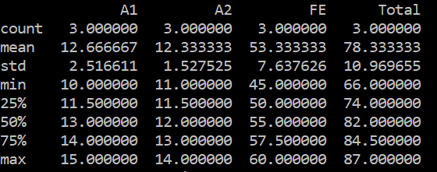
Descriptive Statistics
import pandas as pd
class2 = pd.DataFrame(
dict(Id=['u111', 'u112', 'u113'],
A1=[13, 15, 10],
A2=[14, 12, 11],
FE=[60, 55, 45],
Total=[87, 82, 66]))
class5 = pd.DataFrame(
dict(Id=['u111', 'u112'],
Grade=['HD', 'DI']))
class7 = pd.merge(class2, class5, on='Id', how='outer')
print(class7)
print(class7.describe())

Slide 17
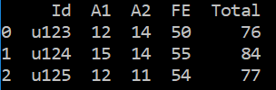




Sorting
unsorted = pd.DataFrame(
dict(Id=['u123', 'u124', 'u125'],
A1=[12, 15, 12],
A2=[14, 14, 11],
FE=[50, 55, 54],
Total=[76, 84, 77]))
print(unsorted)
unsorted.loc[1, 'Total'] = 85
print(unsorted)
sorted1 = unsorted.sort_values(by='Total')
print(sorted1)
sorted2 = unsorted.sort_values(by='Total', ascending=False)
print(sorted2)
sorted3 = unsorted.sort_values(by=['A2', 'Total'])
print(sorted3)

Slide 18
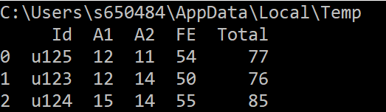
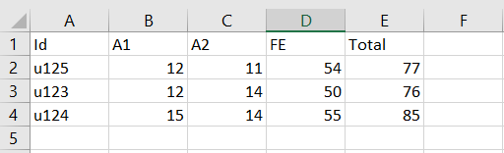
Database - CSV
import tempfile, os.path
tmpdir = tempfile.gettempdir()
csv_filename = os.path.join(tmpdir, "sorted3.csv")
print(tmpdir)
sorted3.to_csv(csv_filename, index=False)
input_csv = pd.read_csv(csv_filename)
print(input_csv)

Slide 19
Database - Excel
#Excel
import tempfile, os.path
tmpdir = tempfile.gettempdir()
excel_filename = os.path.join(tmpdir, "results.xlsx")
print(tmpdir)
sorted3.to_excel(excel_filename, sheet_name='sorted3', index=False)
input_sorted_excel_sheet = pd.read_excel(excel_filename, sheet_name='sorted3')
print(input_sorted_excel_sheet)

Slide 20
Database – Excel with multiple sheets
#Excel with multiple sheets
import tempfile, os.path
tmpdir = tempfile.gettempdir()
excel_filename = os.path.join(tmpdir, "results.xlsx")
with pd.ExcelWriter(excel_filename) as excel_writer:
unsorted.to_excel(excel_writer, sheet_name='unsorted', index=False)
sorted3.to_excel(excel_writer, sheet_name='sorted3', index=False)
input_unsorted_excel_sheet = pd.read_excel(excel_filename, sheet_name='unsorted')
print(input_unsorted_excel_sheet)
input_sorted_excel_sheet = pd.read_excel(excel_filename, sheet_name='sorted3')
print(input_sorted_excel_sheet)

Slide 21
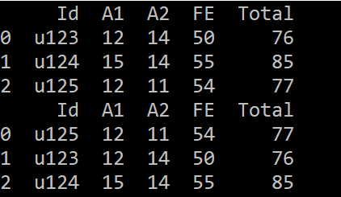
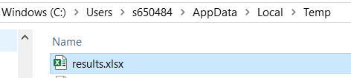
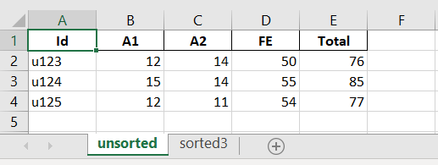
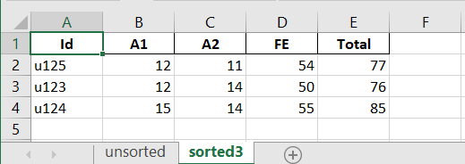
Database – Excel with multiple sheets

Slide 22
Database – SQL (SQLite)
import pandas as pd
import tempfile, os.path
import sqlite3
#Directory and filenames
db_tmpdir = tempfile.gettempdir()
db_filename = os.path.join(db_tmpdir, "results.db")
csv_tmpdir = tempfile.gettempdir()
csv_filename = os.path.join(csv_tmpdir, "sorted3.csv")
#Connect
conn = sqlite3.connect(db_filename)
#Read data from CSV then write data to SQL table sorted3
results = pd.read_csv(csv_filename)
results.to_sql("sorted3", conn, if_exists="replace")

Slide 23
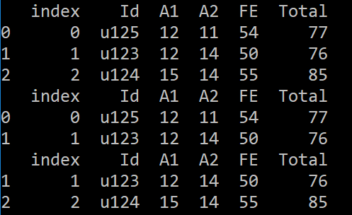
Database – SQL (SQLite) continued
#Read data from sorted3 table
results_sql = pd.read_sql_query("select * from sorted3;", conn)
print(results_sql)
#Read the first 2 rows from sorted3 table
print(results_sql.head(2))
#Read the last 2 rows from sorted3 table
input_sql = pd.read_sql_query("select * from sorted3;", conn).tail(2)
print(input_sql)

Slide 24
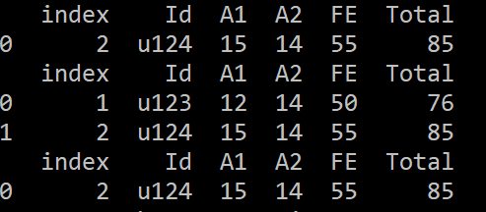
Database – SQL (SQLite) continued
input_sql = pd.read_sql_query('select * from sorted3 where A1 > 14;', conn)
print(input_sql)
input_sql = pd.read_sql_query('select * from sorted3 where A2 = 14;', conn)
print(input_sql)
input_sql = pd.read_sql_query('select * from sorted3 where Total > 80;', conn)
print(input_sql)

Slide 25
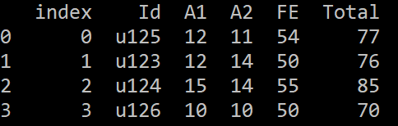
Database – SQL (SQLite) continued – Insert data to table
cur = conn.cursor()
values = (3, 'u126', 10, 10, 50, 70)
cur.execute("insert into sorted3 values (?, ?, ?, ?, ?, ?)", values)
conn.commit()
results_sql = pd.read_sql_query("select * from sorted3;", conn)
print(results_sql)

